Slide 1
Q2 Advocacy Town Hall
Advocacy Fund Grants and Process
June 6th, 2024
Alex McIntyre
Nick Scarci

Slide 2
Thank You to Our Donors Premium

Slide 3
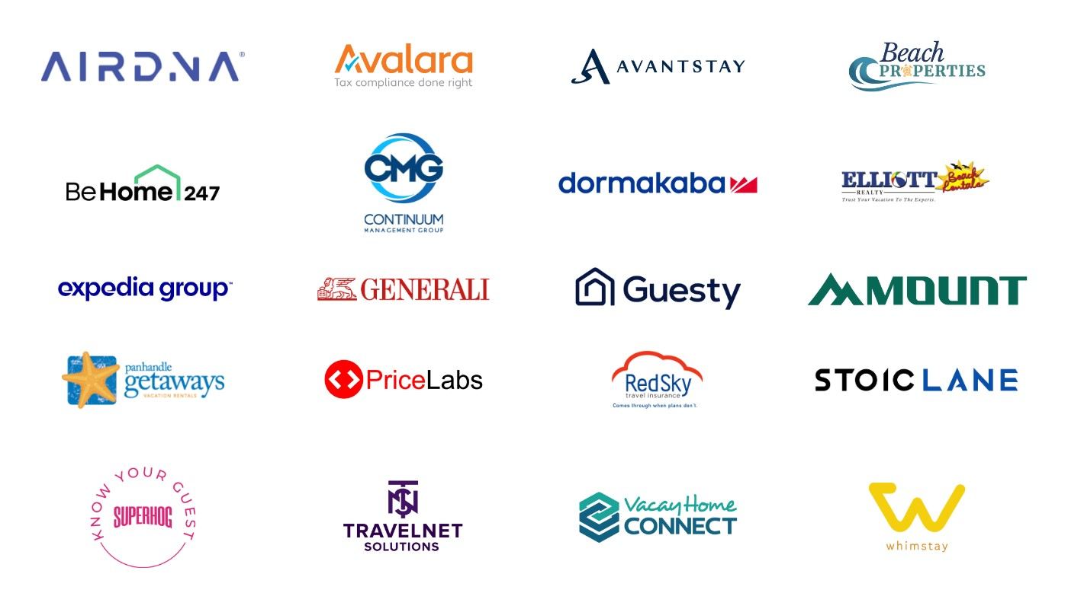
Thank You to Our Donors Tier I

Slide 4
Thank You to Our Donors Tier II

Slide 5
Thank You to Our Donors Tier III

Slide 6
Parameters
Notes:
Before I put these up- no need to copy down, these will all go out on Monday
Rolling questions

Slide 7
VRMA ADVOCACY FUND GRANT GUIDELINES
1. The VRMA Advocacy fund provides financial assistance to support state, local and regional VRMA-affiliated coalitions or organizations to successfully deal with a legislative, regulatory, or ballot issue which could set a national precedent and requires financial support from VRMA to succeed. The Fund seeks to help a variety of groups and coalitions, especially those facing a new issue or who have just created a group, in order to get them started on larger and more robust advocacy efforts.
The most important criteria which the committee will evaluate includes:
Winnability and potential positive outcomes
Potential to set an important precedent
Other funds raised
Specific and detailed plans for the funding
Existing advocacy work and/or a strategy to continue the work into the future
Amount of VRMA members in the local coalition
Data and background provided in the application

Slide 8
2. The maximum VRMA Advocacy Fund financial assistance for the normal Collaborative Committee application process shall not exceed $20,000 unless the committee passes a motion to increase the amount awarded.
Outside of the normal application windows for the Collaborative Committee, if a local organization faces an urgent issue which requires support, they can utilize the VRMA Advocacy Fund Opportunity Fund by notifying staff and completing the same application. The maximum financial assistance is $10,000 and all the below parameters and conditions apply.

Slide 9
3. The committee will only award funding to the same group and/or issue on a case by case basis in rare circumstances.
4. The appropriate state, local or regional affiliated coalition affected by the issue must make the request for funding, submitted in writing via the application, and accompanied by any relevant documentation.

Slide 10
3. The committee will only award funding to the same group and/or issue on a case by case basis in rare circumstances.
4. The appropriate state, local or regional affiliated coalition affected by the issue must make the request for funding, submitted in writing via the application, and accompanied by any relevant documentation.

Slide 11
5. Applicants can only use VRMA Advocacy Fund grants for specific, budgeted items outlined in their application. Requests should also have a professional, accurate estimate or price from a vendor or company. Acceptable budget items should directly relate to achieving success on the issue, such as:
Studies
Reports
Polling
Research data
Draft/model legislation
Public relations (PR) campaign and materials including mailers, text, advertising, media production, etc
Consultants tasked with a specific function such as developing PR campaign materials
Seed funding for a multi-year, sustained lobbyist.
Applicants will need to show additional funding to support the lobbyist beyond the scope of the grant

Slide 12
The funds may not be used for:
Staff salaries
General operating expenses
Other overhead costs by the organization
Litigation or lawsuits
Campaigns by individual political candidates
Issues which VRMA has already awarded funds for
Membership drives

Slide 13
6. VRMA members in good standing must make up a majority of the applying coalition to apply for a grant from the Advocacy Fund. Applications should come from an organized short-term vacation rental (STVR) alliance and not from a singular member.
7. The coalition’s position on an issue cannot conflict with any VRMA Policies.
8. The Collaborative Committee reviews applications who will then submit their recommendations to the VRMA Executive Committee to vote on and approve final funding

Slide 14
Section 2: Award Conditions
9. Upon notification of VRMA award, the coalition will need to sign VRMA’s Memorandum of Understanding within thirty days (provided by staff). Once the MOU is signed, the funds must be used within one year of the signing date. The MOU details the conditions of the award, outlined below
10. The VRMA affiliated coalition receiving financial assistance under these guidelines shall, until the issue is finalized, provide VRMA with a minimum of two (2) written updates per calendar year on how the funds are being utilized, other VRMA resources the coalition has used, and how other affiliated coalitions facing similar issues can replicate their efforts. If the coalition has ongoing calls or remote meetings, they should add VRMA staff onto those calls to both ensure compliance with parameters of the award and receive additional advice to help their efforts

Slide 15
11. The VRMA affiliated coalition receiving funds shall provide VRMA the opportunity to be recognized as a Partner. The coalition must provide VRMA with copies of any collateral materials developed as part of their overall campaign so VRMA can make them available to other affiliated coalitions facing similar issues/situations. The materials will be property of VRMA.
12. Recipient shall spend the Grant within a period of one calendar year commencing at the date of their signed MOU. If there are funds remaining after one calendar year, they will be automatically relinquished back to the VRMA Advocacy Fund.
13. Any press release or other public announcement of the grant by the recipient shall be submitted to, and approved by, VRMA in advance.

Slide 16
14. Unless otherwise noted in writing and approved by the VRMA Executive Committee, funding will be distributed directly to the consulting, lobbying or other appropriate vendors and not to the affiliated coalition’s operating bank account.
15. The applying affiliated coalition is solely responsible for any and all reporting requirements, which may apply as a result of receiving monies from the VRMA Advocacy Fund for taxation and political/lobbying or state ethics purposes.
16. If the applicant makes substantive changes to the initial application after approval by the Collaborative Committee, staff reserves the right to determine whether the request must go back to the Collaborative Committee for reapproval

Slide 17
Timeframe
• Monday June 10th Application Period Opens
• Friday June 28th- Application period closes
• Weeks of July 1st and 8th Follow-up with applicants
Week of August 5th- Collaborative Meeting and Final Decision
Next Application Period will take place in late August/September
Notes:
Long timeframe- these projects are supposed to be strategic and long-term, not immediate
Otherwise we have

Slide 18
Projects

Slide 23
Questions on Projects?

Slide 24
Application

Slide 42
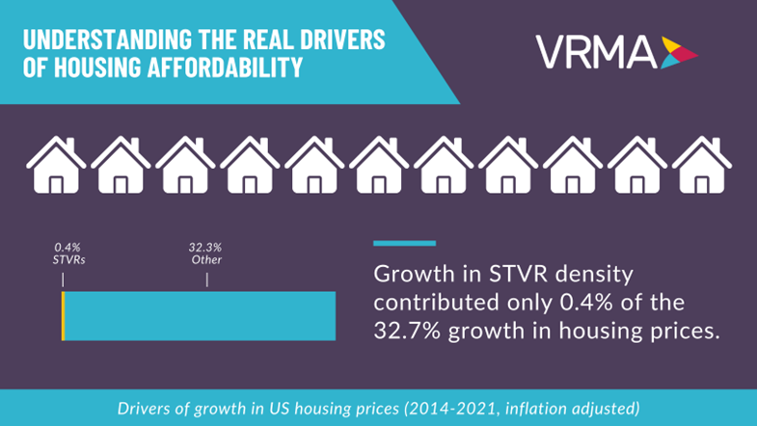
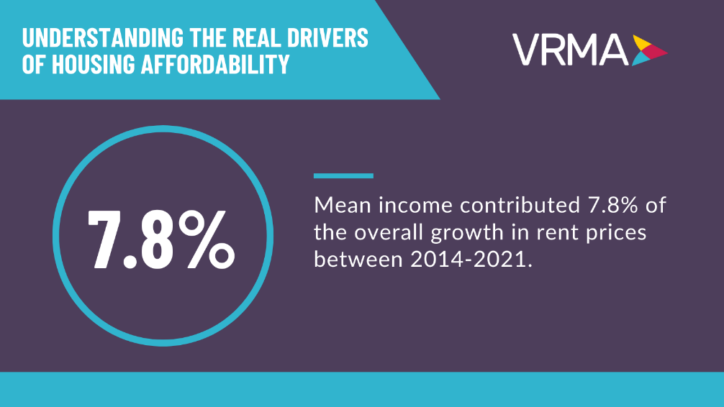

Slide 56
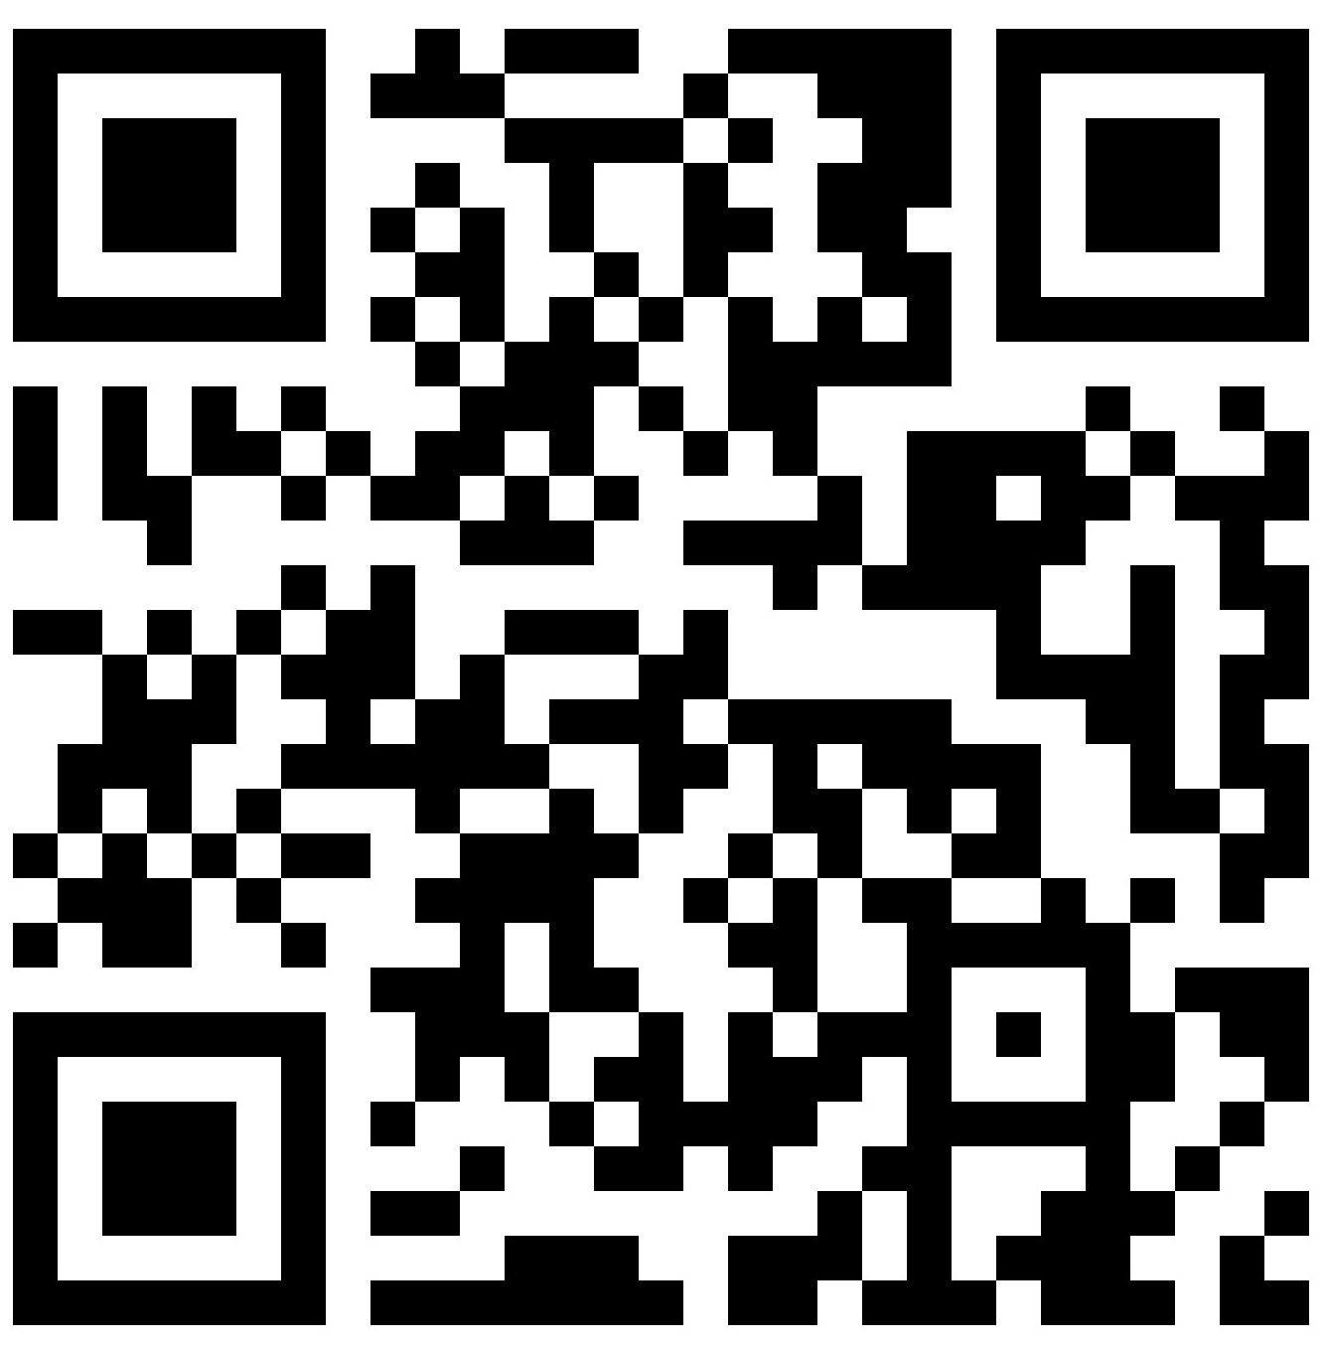
Notes:
Raise your hand if you are a FL resident!

Slide 57
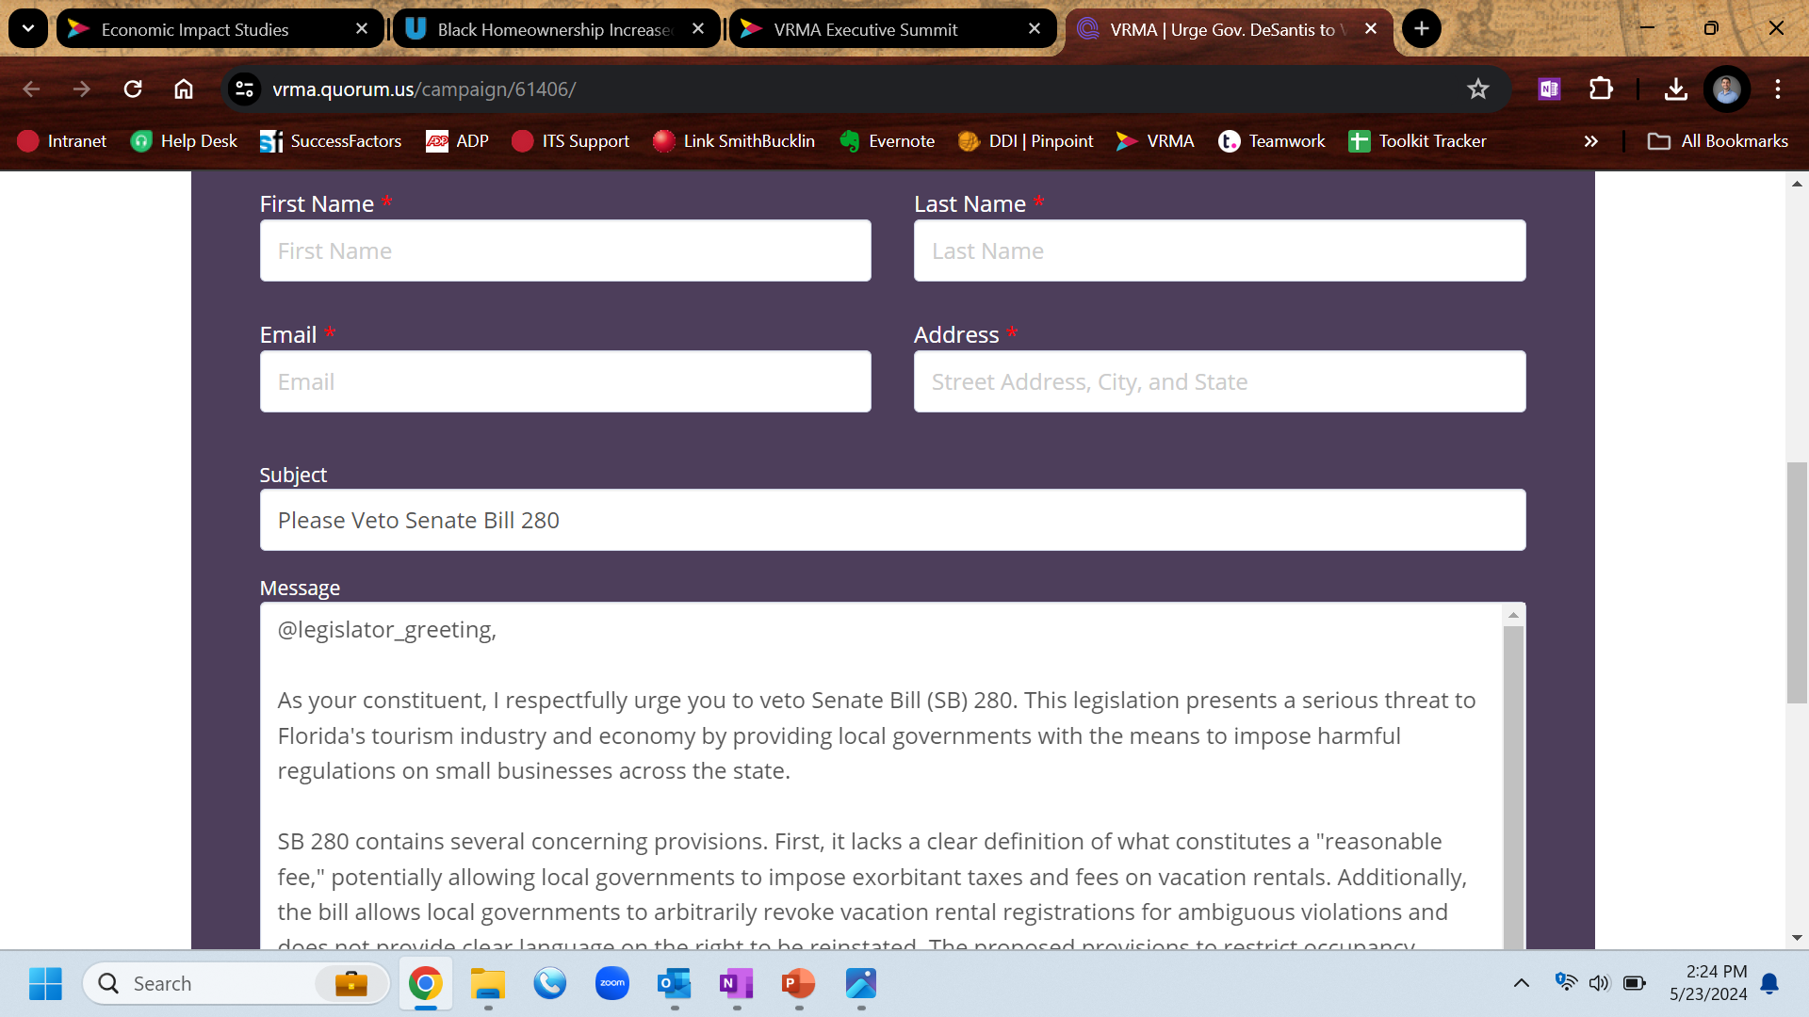

Slide 58
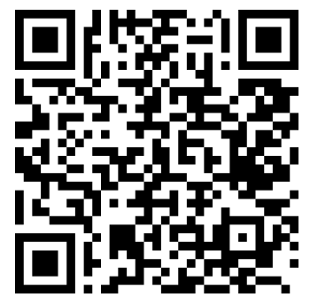
Support Our Advocacy Efforts
The VRMA Advocacy Fund helps fight for reasonable regulations that benefit both communities and the vacation rental market. Scan the QR code to learn more!

Slide 59
Contact Information
Nick Scarci
niscarci@vrma.org
Alex McIntyre
amcintyre@vrma.org
Thanks for joining!

